Slide 1
WIZTECH
AUTOMATION SOLUTIONS PVT. LTD.
EMBEDDED SYSTEM

Slide 2
Basics of C Language
Fundamentals of C
Data types and sizes
Console Input/output
Operators and Expressions
Control Statements
Functions and Program Structure
Arrays and Pointers
String Manipulation
Macros

Slide 3
Advanced C Programming
Storage Classes
The C Preprocessor
Structures
Unions
Typedef, Type casting
Enumeration
File Handling

Slide 4

C in LINUX
Introduction to LINUX
Basic Linux Commands
Using VI Editor
Headers, Linking, Make files
Advanced Debugging
Error Handling
Dynamic memory Handling
Command line argument

Slide 5
Basics of C++
OOPS Concepts
Introduction to C++
Name space standard
Classes and Objects
Functions and overloading
Polymorphism
Inheritance
Constructors and Destructors
Pointers and references

Slide 6
Advanced C++ Programming
Data abstraction
Encapsulation
Data hiding
Friend, Static, Virtual, Inline
Structures and Unions
File Handling
Dynamic memory
Exception Handling
Templates
Reference variables

Slide 7
Controllers
8 BIT
8051 (AT89C51)
PIC24F
32 BIT
ARM7 – LPC2148
PIC16F
PIC18F
Atmega32
ARM9 – S3C2440
Cortex M3
ARM11 – S3C6410
16 BIT
LPC1313
LM3S316
MSP430
XMEGA

Slide 8
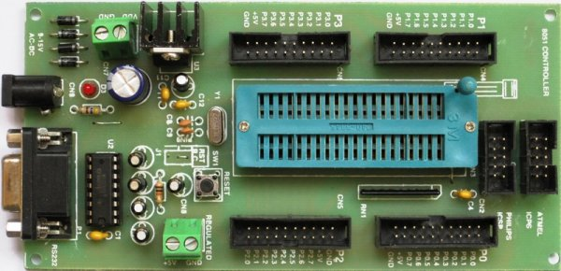
8051 Microcontroller
Features of 8051
Architecture
Pin Diagram
Memory
Assembly Language Programming
CISC
Embedded C
Peripheral Interfacing
Analog to Digital Convertor
Timer & Counter
UART
Interrupt
PROJECT
DEVELOPMENT
Keil μ vision 3
Proteus
Flash magic

Slide 9
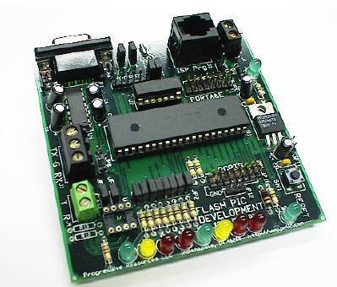
PIC16F Microcontroller
Features of PIC microcontroller
Datasheet analysis
Architecture
RISC vs. CISC
Peripheral Interfacing
Timer & Counter
ADC
Communication Protocols
Interrupts
Compare, Capture, PWM
Watch Dog timer
Fuses
INDUSTRIAL AUTOMATION BASED PROJECT
CCS C Compiler
HI-TECH C Compiler
MPLAB
Proteus
PIC Kit3

Slide 10
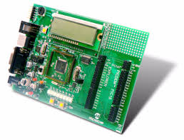
PIC18F Microcontroller
Special Features of PIC18F MC
High-Performance RISC CPU
Peripheral Interfacing
Different Timer modules
Analog Features
Interrupts
CCP
WDT
Network Protocols
Fuses
CCS C Compiler
HI-TECH C Compiler
Proteus
PIC Kit3
REAL TIME PRODUCT BASED PROJECT

Slide 11
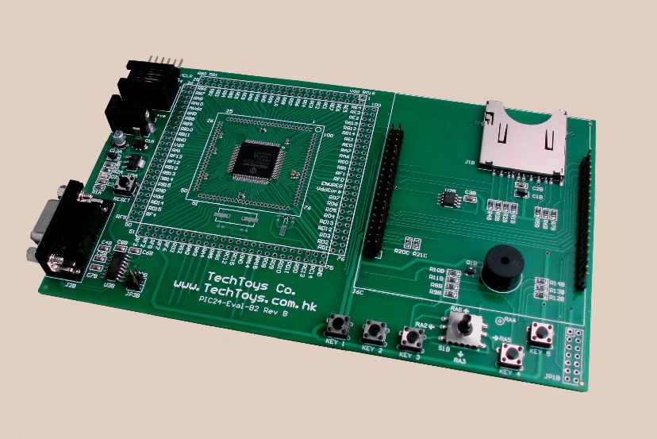
PIC24F Microcontroller
Features of PIC24F
External Peripheral
Timer/Counter modules
Analog Comparators
ADC Features
Interrupt
CCP
WDT
RTC & Alarm
Network Protocols
CCS C Compiler
Proteus
PIC Kit3
AUTOMOBILE BASED PROJECT

Slide 12
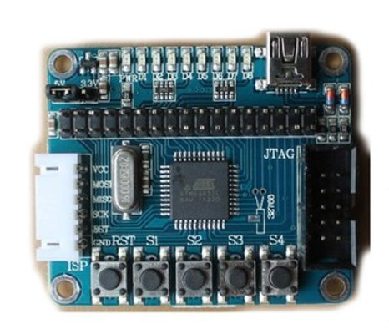
AVR Microcontroller
Features of AVR microcontroller
Datasheet analysis
Architecture
RISC vs. AVR
Peripheral Interfacing
Timer & Counter
ADC
Communication Protocols
Interrupt
Compare, Capture, PWM
Debugging
ROBOTIC PROJECT DEVELOPMENT
AVR studio 4
AVR GCC Compiler
Proteus
JTAG ICE

Slide 13
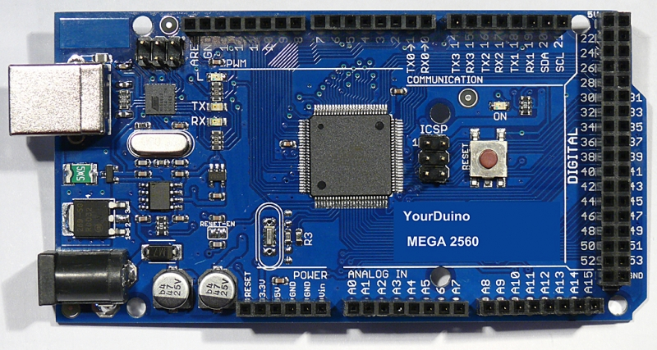

Arduino-Mega 2560
Basics of Arduino Programming
Keywords, built-in function, Libraries
Creating a sketch file
Working with Arduino MEGA ID
Hardware specifications
Digital GPIO programming
Peripheral interfacing
Arduino MEGAVSM model in Proteus
Serial communication with PC
Interrupt handling
AUTOMATIC GUIDED VEHICLE (AGV)
Interfacing SD card
Interfacing Bluetooth
Arduino
Proteus

Slide 14
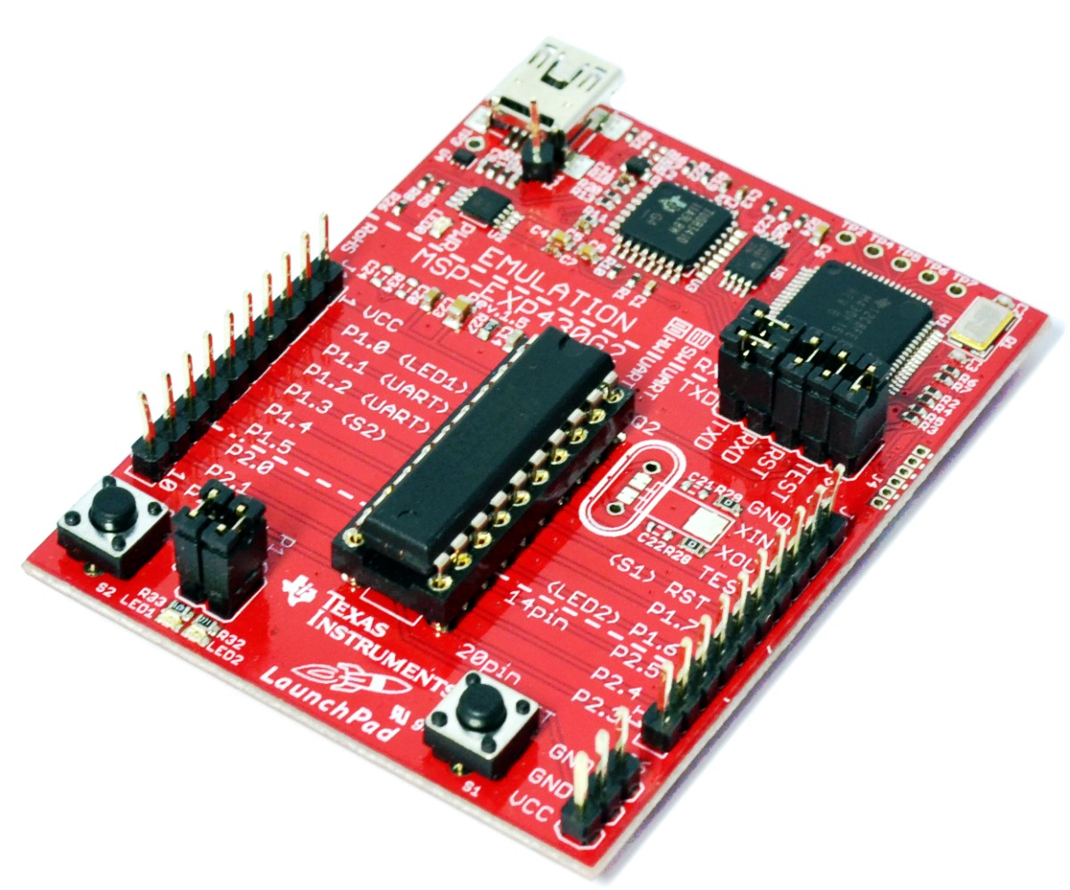
MSP430
Basics of Programming in Energia
Keywords, built-in function, Libraries
Creating a sketch file
Working with MSP430ID
Hardware specifications
Digital GPIO programming
Peripheral interfacing
Serial communication with PC
Interrupt handling
SD card interfacing
AUTOMATIC GUIDED VEHICLE (AGV)
Energia
Proteus

Slide 15
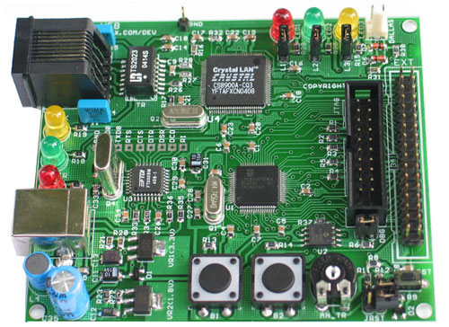
ARM7 TDMI
Introduction to ARM
AMBA & AHB
Features of LPC2148
Datasheet analysis
GPIO programming
Peripheral Interfacing
System control block
ADC & DAC
Communication Protocols
Timer
Match, Capture, PWM
Vectored Interrupt Controller
RTC & Alarm
Watch Dog timer
Debugging
PROJECT DEVELOPMENT
Keil μ vision 4
ARM GCC Compiler
Proteus
ULINK 2 (JTAG)

Slide 16
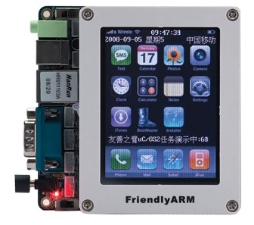
ARM9 s3c2440
Introduction to ARM9
Architecture
Features of s3c2440
Datasheet analysis
GPIO programming
Pin diagram
Peripheral Interfacing
Timer and counter
ADC & DAC
Communication Protocols
Interrupt Controller
Debugging
Graphical user interface
User App Development
No OS mode
RTOS in ARM9
PROJECT DEVELOPMENT
Keil μ vision 4
DNW
Hyper terminal

Slide 17
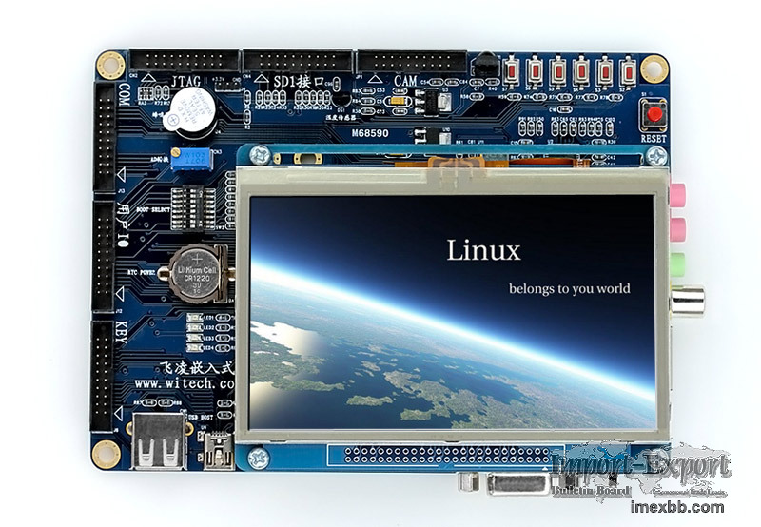
ARM11 s3c6410
Introduction to ARM11
Architecture
Features of s3c6410
Datasheet analysis
GPIO programming
Pin diagram
Peripheral Interfacing
Timer and counter
ADC & DAC
Communication Protocols
Interrupt Controller
Debugging
Graphical user interface
User App Development
No OS mode
RTOS in ARM11
PROJECT DEVELOPMENT
Keil μ vision 4
DNW
Hyper terminal

Slide 18
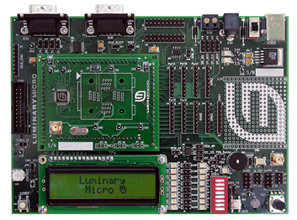
ARM CORTEX – M3
LM3S316
Introduction to ARM CORTEX- M3
Overview and architecture of
ARM CORTEX
Applications
ARM CORTEX M3 vs arm 7
Pin connect block
Peripherals interface
32 bit & 16 bit timer accessing,
Sensor interfacing
ARM Firm-compliant Watchdog Timer
16C550-type UART communication
Ssi,i2c protocols
JTAG TAP Controller
SD card interfacing
PROJECT DEVELOPEMENT
Coocox IDE
Keil
Proteus

Slide 19
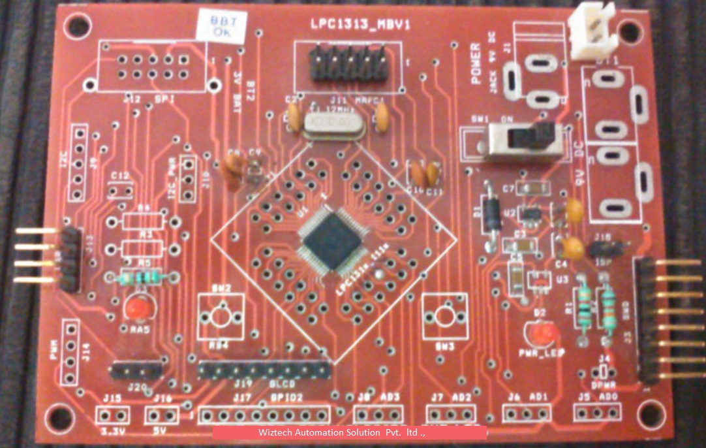
ARM CORTEX – M3
LPC1313
Features of LPC1313
Datasheet analysis
GPIO programming
Peripheral Interfacing
System control block
ADC & DAC
Network Protocols
Timer Features
CCP
Vectored Interrupt Controller
RTC & Alarm
WDT
Debugging
PROJECT DEVELOPMENT
Keil μ vision 4
Proteus
ULINK 2 (JTAG)

Slide 20
Peripheral Interfacings
LED & Bar graph LED
Seven segment display
Switches and push button
Alphanumeric LCD
Linear Keypad
Matrix Keypad
DC motor
Stepper motor
Servo motor
Relay
Buzzer
8255 Interfacing
ADC, DAC Interfacing
Ext. EEPROM
MAX7221 Interfacing
Real-Time Clock(RTC)
Graphical LCD
TFT Display
Touch Screen

Slide 21
Embedded Networking
Embedded
Basics of Communication Protocols
RS232, RS422, RS485
Serial peripheral Interface (SPI)
Inter – Integrated Circuits (I2c)
Universal Serial Bus (USB)
TCP/IP
Automotive
Controller Area Network (CAN)
Media Oriented System Transport (MOST)
Local Interconnect Network (LIN)
J1850
Flex Ray

Slide 22
Application Embedded
RF Transceiver
ZigBee
RFID
Bluetooth
DTMF
GSM, GPRS
Global Positioning System (GPS)
SD card Interfacing

Slide 23
Robotics
MOTORS
D.C. motor
Stepper motor
D.C. Servo motor
A.C. Servo motor
DRIVES
Pneumatic
Hydraulic
Mechanical
Electrical
Drives vs. Effectors
GRIPPERS
Pneumatic
Hydraulic
Mechanical
Magnetic
Vacuum
Fingered

Slide 24
Sensor Interfacing
Infra-red sensor
PIR sensor
LDR sensor
Optical Encoders
Ultra sound sensor
Hall effect sensor
Knock sensor
Touch sensor
Temperature sensor
Pressure sensor
Vibration sensor
Humidity sensor
Pyro sensor
Peizo electric sensor
Accelerometer
Gyroscope
Color Sensor
Current sensor
Load cell
Finger print sensor
Flex sensor
Biomedical Sensors
pH sensor
Gas sensor
Alcohol sensor
Flow sensor
Level sensor
Viscosity sensor
A/D conversion
Sampling
Quantization
Resolution
Calibration

Slide 25


RTOS
Boot loader
Kernel
File management
Process management
Memory management
Hardware Abstraction Layer
Free RTOS
µ COS II

Slide 26

Machine Vision & MATLAB
Introduction to MATLAB
Fundamentals of image processing
Introduction to
Machine Vision
Image acquisition
Frame Grabber
Image storage
Data reduction
Edge detection
Segmentation
Object Recognition
Visual serving and Navigation

Slide 27

Labview
Introduction to Virtual instruments
Sub –VIs
Loops and Charts
Arrays & File I/O
Array functions & Graphs
Strings, Clusters, & Error Handling
Case & sequence structures, Formula Nodes
Printing & Documentation
Remote Front panels
Data Acquisition Unit (DAQ)
Serial port
Ethernet
Script

Slide 28
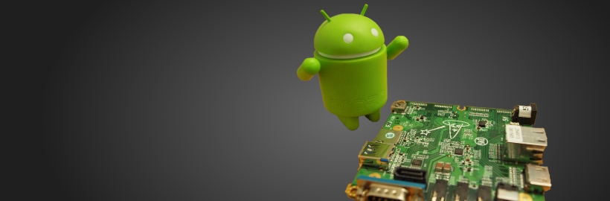
Android
Core Java
Developing Android application
ADK configuration
User Interface
File management
PSP interfacing
Bluetooth
GSM, GPRS
WIFI
GPS
Android App for controlling Robots

